Slide 1

CubeSat Command, Control and Communications Module AKA: Sputnik
Members:
William Harrington
James (Jake) Heath
Michael Mathis
Shan Quinney
Sponsor:
Portland State Aerospace Society

Slide 2
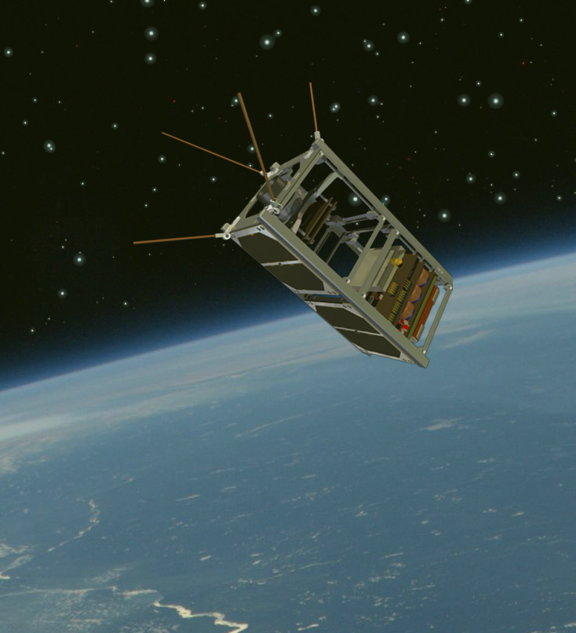
Introduction
One of PSAS’s missions is to get a CubeSat into Lower Earth Orbit (LEO)
Need a module for command, control and communication (C3) between the CubeSat and the ground station
The code name for the module is Sputnik because of it's requirements to be a simple, reliable space system.
Notes:
Problem or Need : What is the problem being solved? Where does it arise?
→ Portland State Aerospace Society has a need of a device that can communication between a CubeSat and a ground Station. The commercial Boards
2

Slide 3

Motivation
Two NASA programs make that possible, the NASA CubeSat Launch Initiative and NASA’s Educational Launch of Nano-Satellites program.
Launch Oregon’s first small educational satellite (aka OreSat)
Build the first and most important avionics modules for the CubeSat

Slide 4
Objective
Rapidly prototype C3 Module that can
Handle long distance RF communications to and from a Low Earth Orbit
Controlling and communicating with a payload that is housed within the CubeSat
Notes:
What is the specific objective of this project?A design? Aworking prototype?
4

Slide 5
Bigger Picture
Building a C3 system from scratch to meet
The harsh environment of space
Compliance with governmental regulations
Programming the module to perform the aforementioned duties
Testing and verifying the device
Documentation
Adhering to the PSAS open-source standard

Slide 6
Project Requirements
Environment
Use parts rated in an Industrial Operating Temperature Range (−40°C to 80°C)
Communication (radio)
Operate in the 70 cm ISM band (436 to 438 MHz)
Use IARU specified frequency for RF comms. and make appropriate changes if necessary
Meet FCC Amateur Radio Licensing requirements (Title 47 CFR part 97)
Meet 400 km link budget
Have bidirectional communication interface to payload via UART
Local storage for communication in/out queues
Energy storage
Use an energy storage system to power the modules when not in sunlight
Energy Switching/Control
Be able to seamlessly switch energy sources to the load
System controller ("Controller")
Radiation tolerant analogue "system watchdog" controller
Power switches to turn other blocks on and off
Monitor energy storage and energy harvesting systems (no)
Communication link with communication block (kind of)
CubeSat requirements
Conforms to latest CubeSat specification where applicable
Fits in 1/4 1U CubeSat
Weighs less than 250 g

Slide 7
Stretch Goals
In general
Use as many COTS (Commercial Off The Shelf) parts as possible
Energy Storage
Monitor the state of charge of the battery
Voltage
Current
Charge (Coulombs)
Environment
Operate in the Automotive Operating Temperature Range (−40°C to 125°C)
Operate in Military Operating Temperature Range (-55°C to 125°C)
Be able to operate in a near-perfect vacuum
Handle 15g in the "Z" axis
Communication (radio)
Use a frequency of 436.5 MHz for RF communication

Slide 8
Deliverables
Hardware
2 fully working C3 Modules in the CubeSat 0 form factor
UART to Sputnik radio adapter for test/debug
Firmware
Basic Sputnik functionality for KW0x microcontroller
Low Gain Radio
Drivers
Radio (9.6 kbps bi-directional communication using GFSK)
SPI
UART
System Controller
Drivers
I2C
UART
Simple demonstration of monitoring of power system through I2C
Simple demonstration of watchdog system to turn on and off other system blocks
System Level
Radio works: 9.6 kbps bi-directional communication, using GFSK demonstrated over 10 km
System controller can turn other blocks on and off

Slide 9
Approach
Decided to have two separate modules that together make C3
LGR – Low Gain Radio
Communications pipeline
System controller
Receive and execute commands (Command/Control)
Divide and conquer!
LGR – Will, Jake
System Controller – Shan, Mike

Slide 10
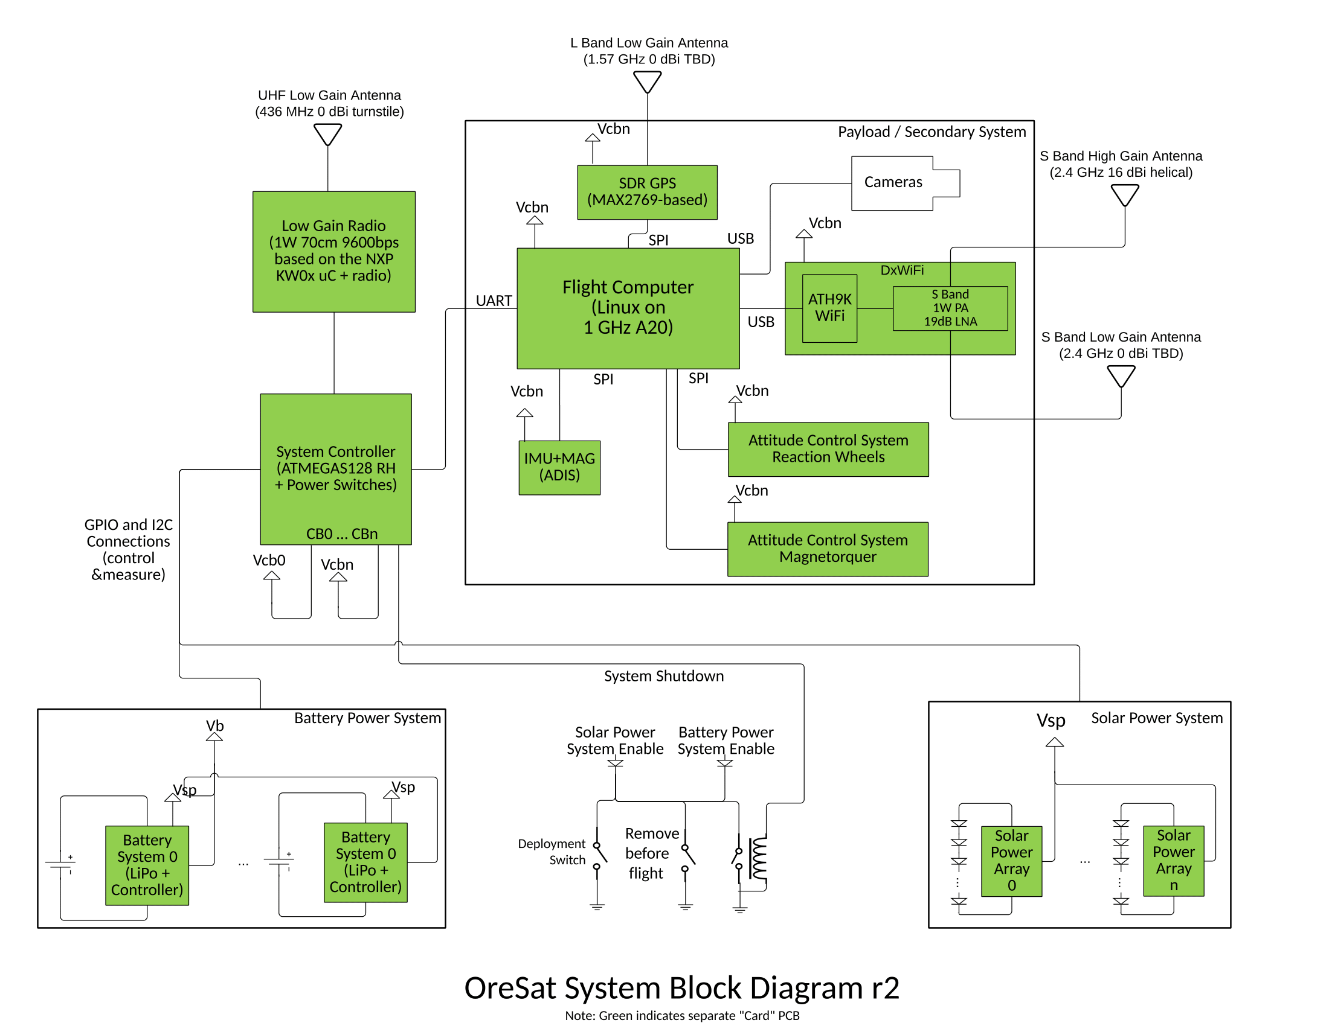
OreSat Low Level Diagram
Notes:
May need multiple subAheadings here (e.g. H/W and S/W, or multiple subsystems) Describe design using appropriate methods (e.g. UML models, algorithms) Discuss design alternatives, tradeAoffs, decisions made
10

Slide 11
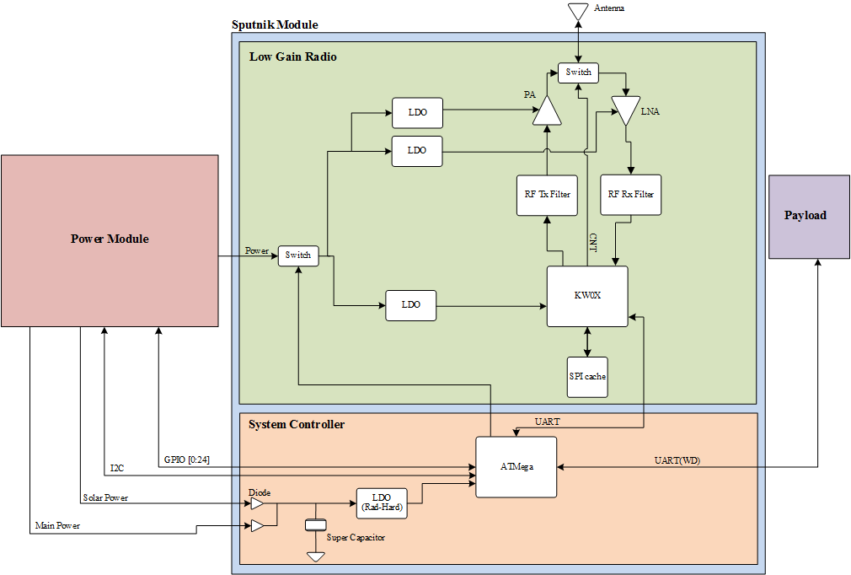
Sputnik Low Level Diagram
Notes:
May need multiple subAheadings here (e.g. H/W and S/W, or multiple subsystems) Describe design using appropriate methods (e.g. UML models, algorithms) Discuss design alternatives, tradeAoffs, decisions made
11

Slide 12
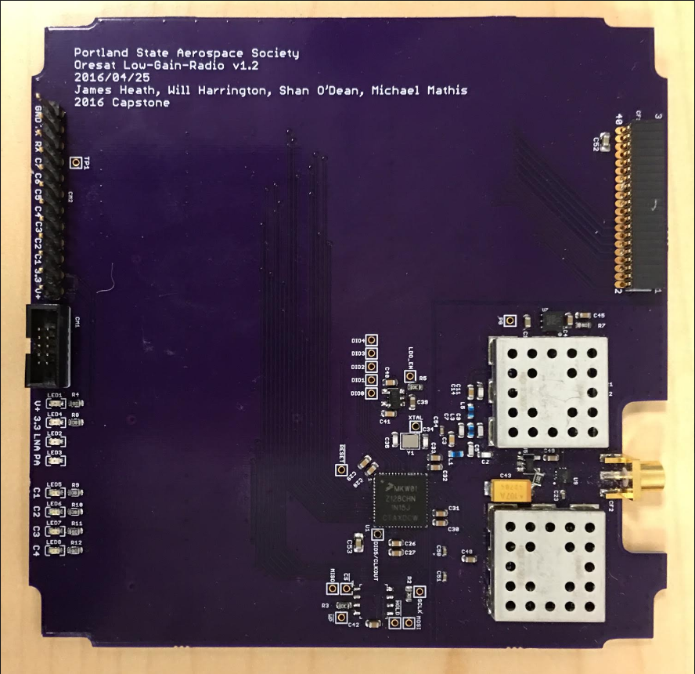
Low Gain Radio (LGR)
Definition
Requirements
Block Diagram
Schematic
Layout
Firmware
Testing Results

Slide 13
Definition (LGR)
Low-gain radios (LGRs) provide wide-angle coverage, but in turn have lower gain. LGRs are designed to be useable for relatively low data rates as long as the satellite is within line of sight of the receiver.
Low-gain so that we can control the CubeSat no matter what the orientation
Main communication pipeline for the satellite

Slide 14
Requirements (LGR)
Operate in the 70 cm ISM band
436.5 MHz
Meet 400 km link budget
Need output power of up to 1 Watt
Adhere to FCC Amateur Radio Licensing requirements (Title 47 CFR part 97)
2nd Harmonic is less than 40dB of desired signal strength
Have bidirectional communication interface to system controller via UART
Local storage for communication in/out queues

Slide 15
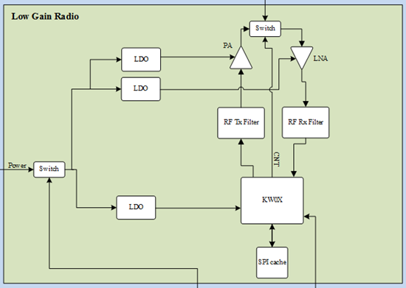
Block Diagram (LGR)

Slide 16
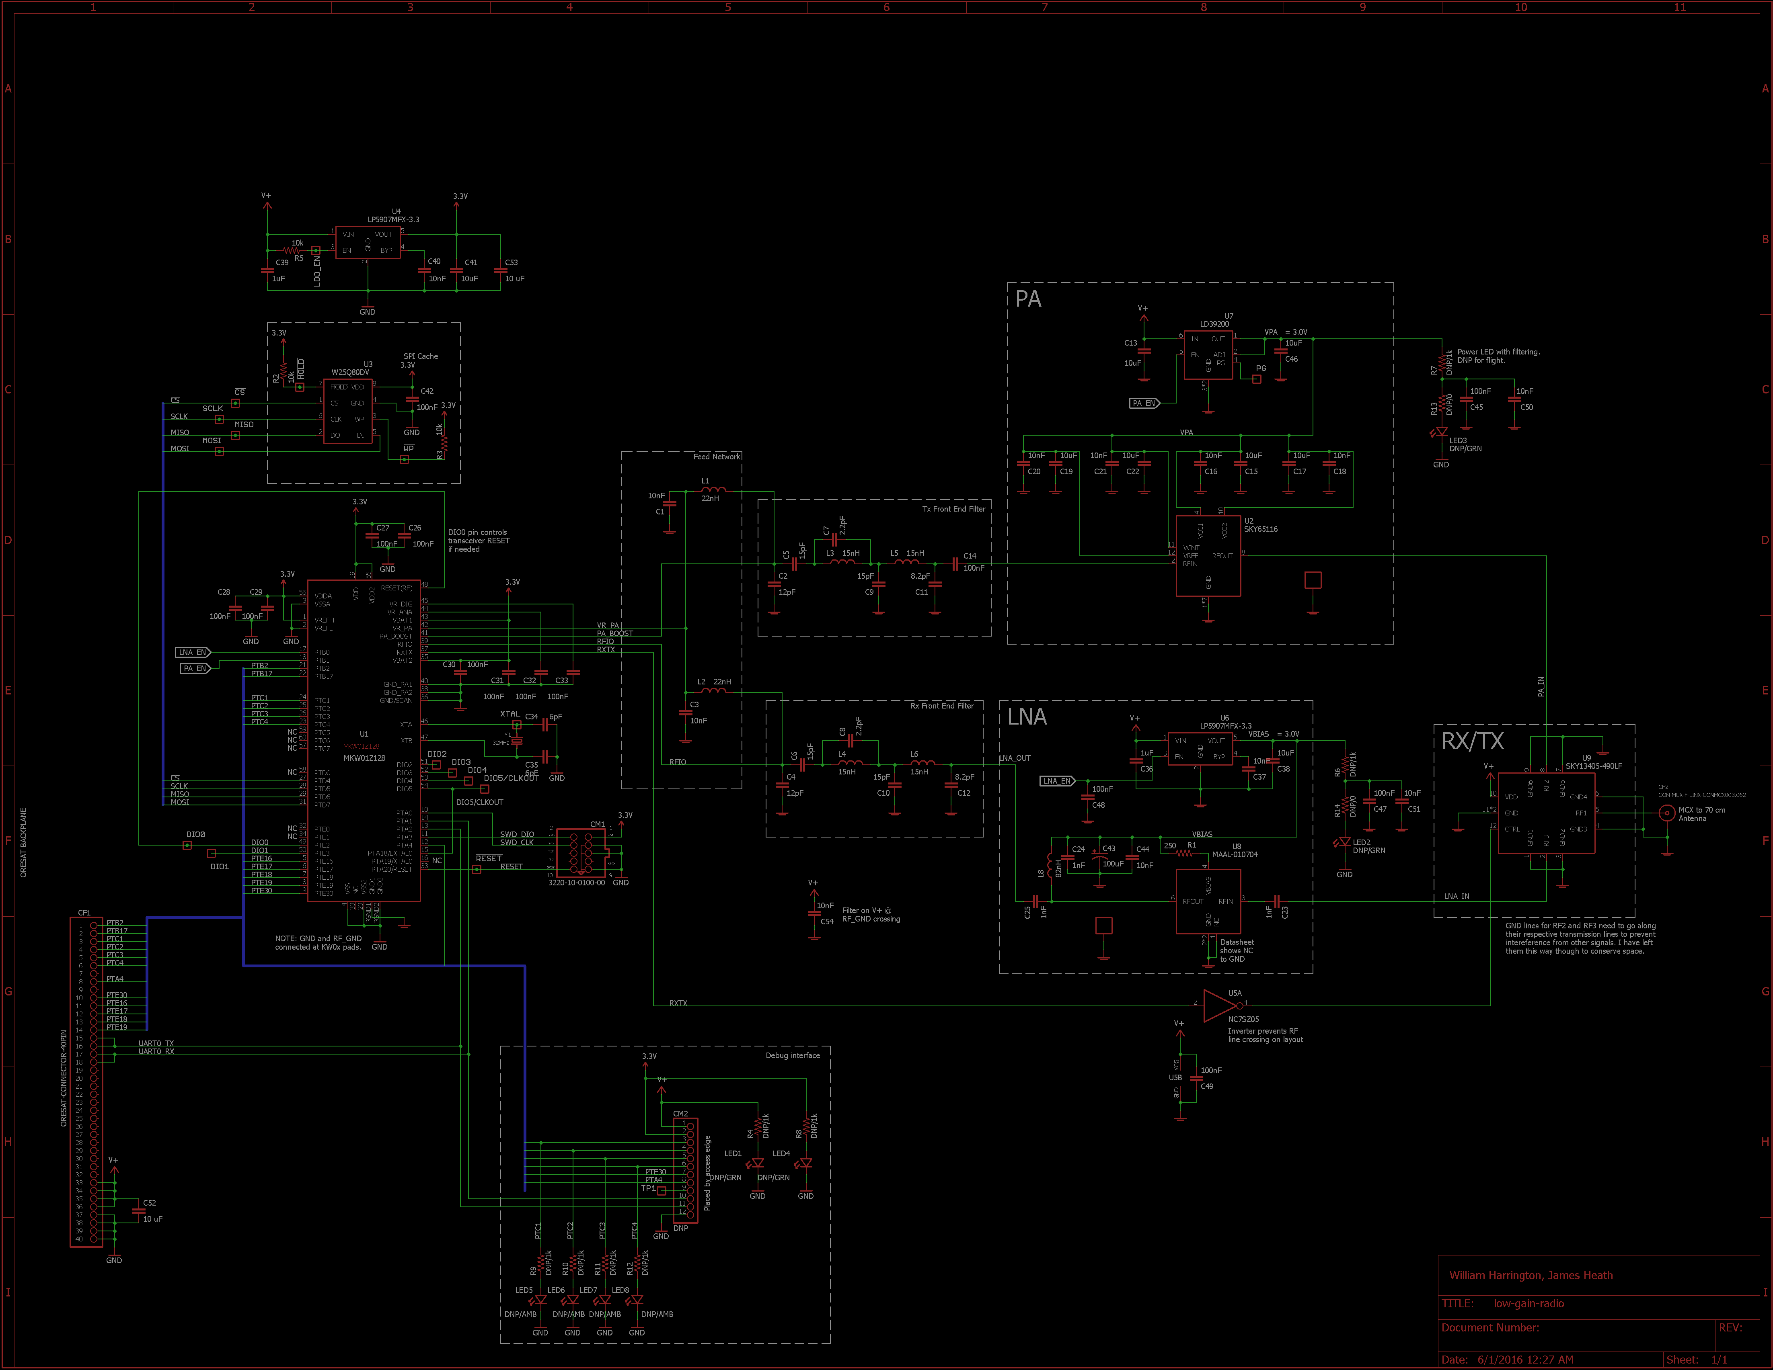
Schematic (LGR)
Notes:
16

Slide 17
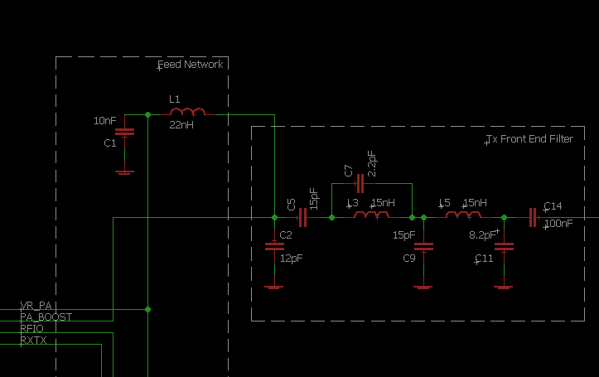
Filter Schematic (LGR)

Slide 18
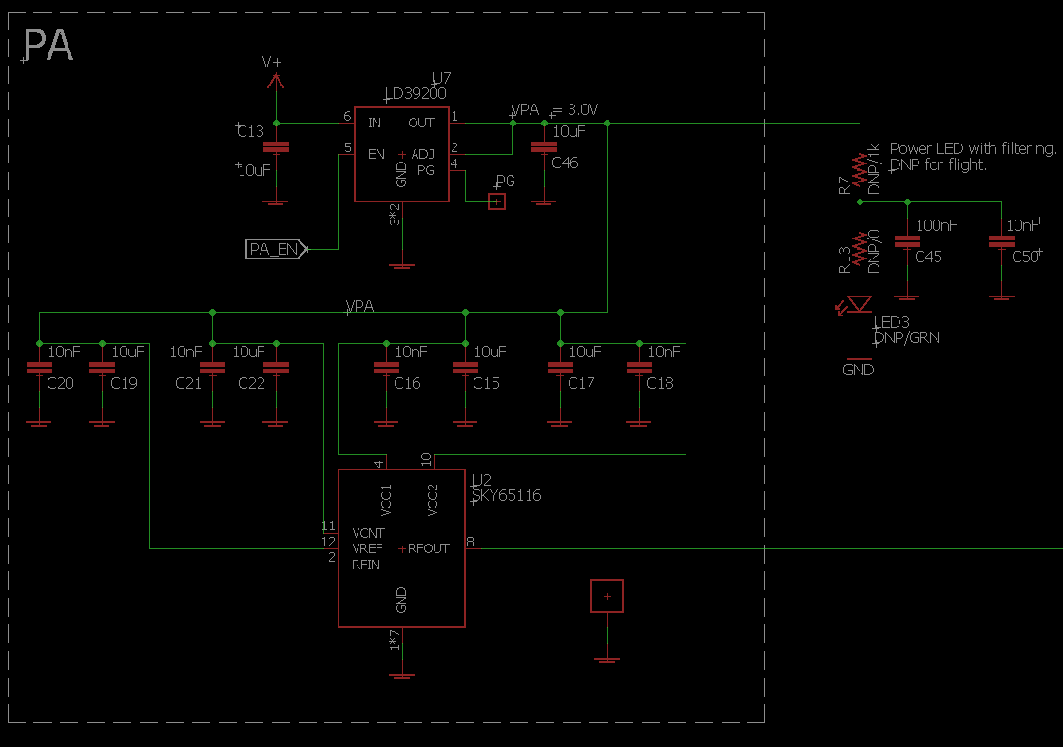
PA Schematic (LGR)

Slide 19
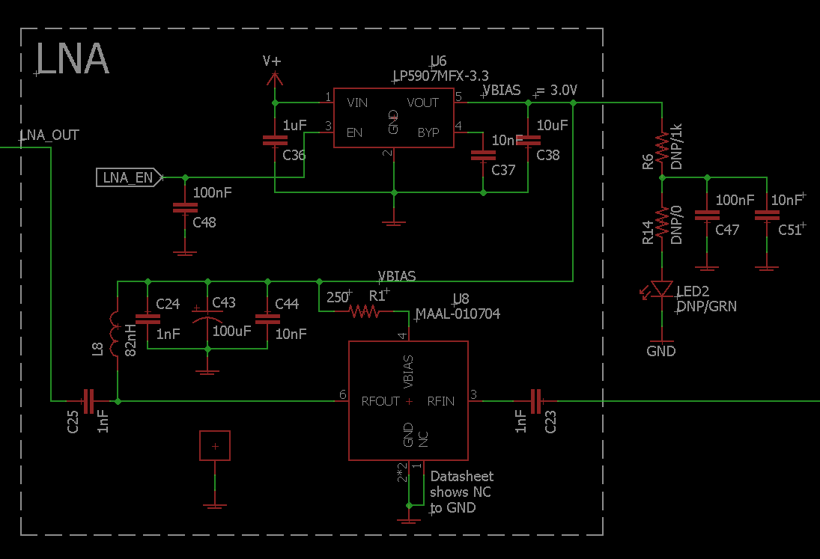
LNA Schematic (LGR)

Slide 20
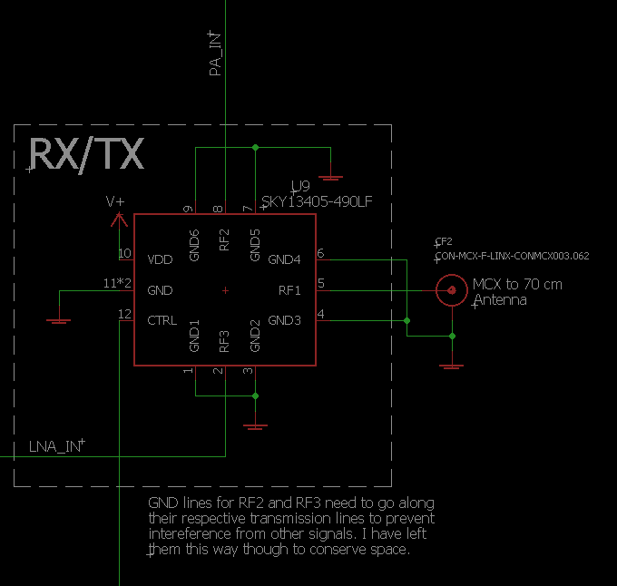
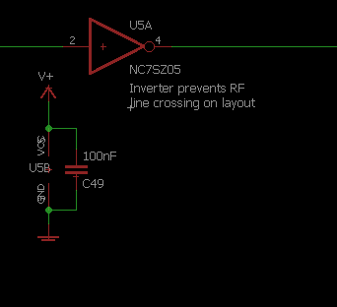
RX/TX Switch Schematic (LGR)

Slide 21
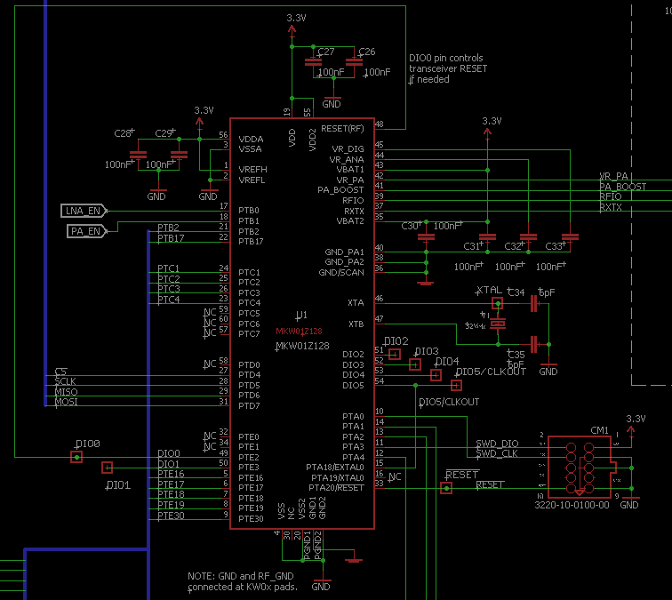
MCU Schematic (LGR)

Slide 22
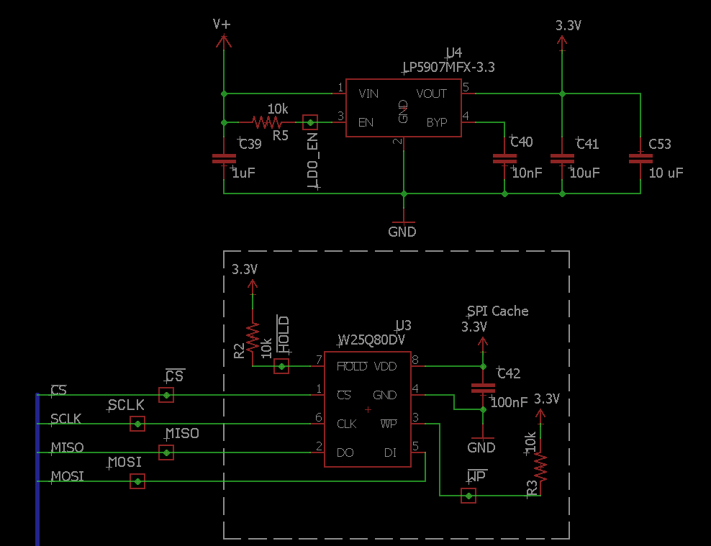
SPI Cache/LDO(MCU) Schematic (LGR)

Slide 23
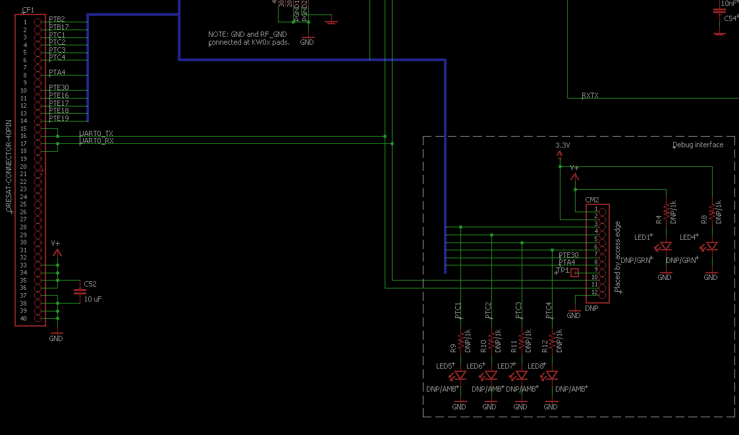
Debug Pins Schematic (LGR)

Slide 24
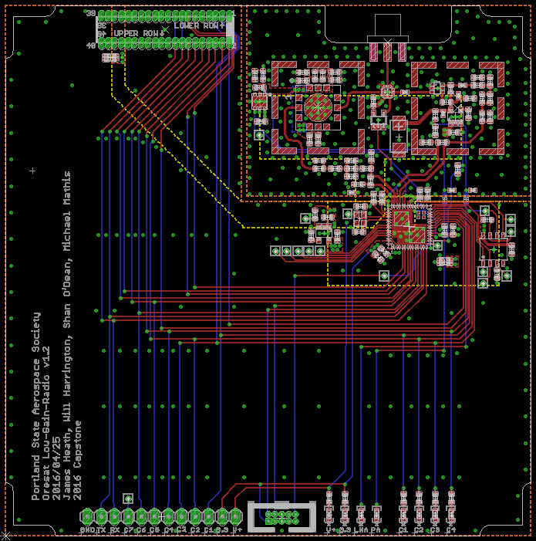
Board Layout (LGR)
Notes:
24

Slide 25
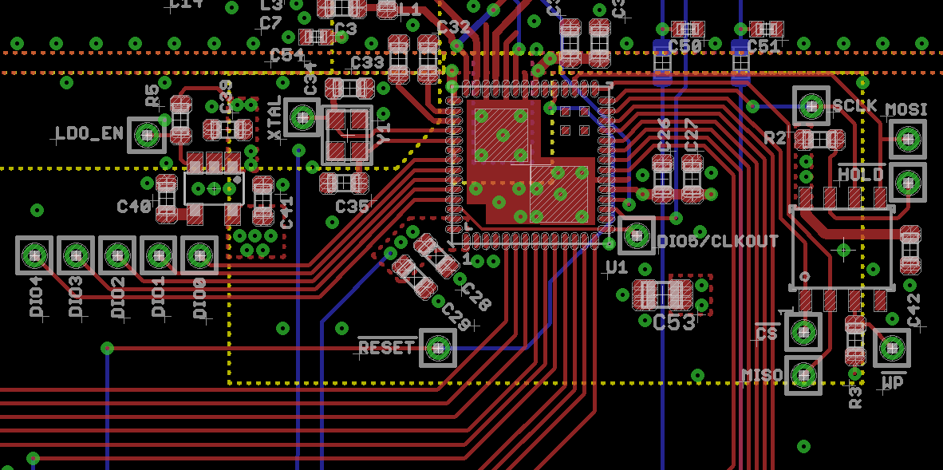
MCU/SPI Cache Layout (LGR)

Slide 26
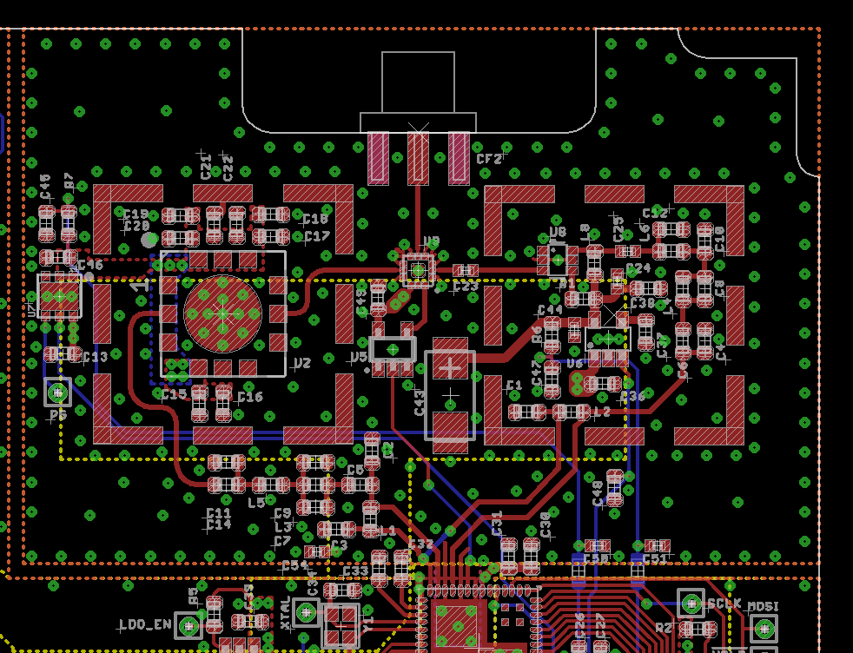
RF Layout (LGR)

Slide 27
Firmware (LGR)
Drivers
Clock
GPIO
SPI
UART
Transceiver
Main loop
RX/TX
Uses SPI
Print to UART
Blink LEDs

Slide 28
Testing (LGR)
Main Tests:
Supply Range Test
Ensure radio works over variable range from 3-5 V
Filter Tests
Practicum filters
Radio Test
Confirms radio is capable of transmitting and receiving
Functionality Test
Confirms radio transmission distance

Slide 29
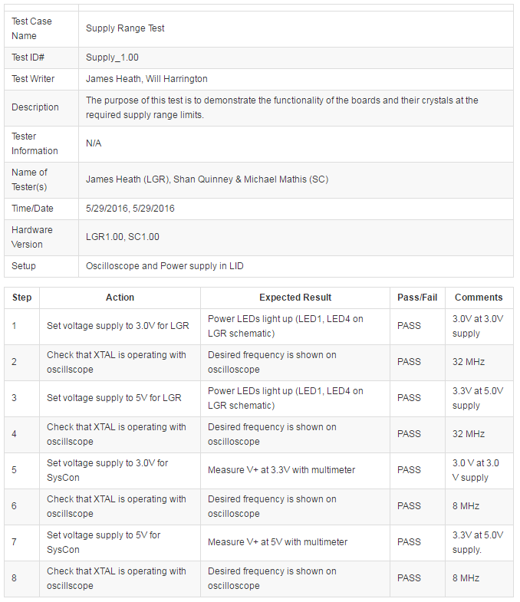
Supply Range Test (LGR)

Slide 30
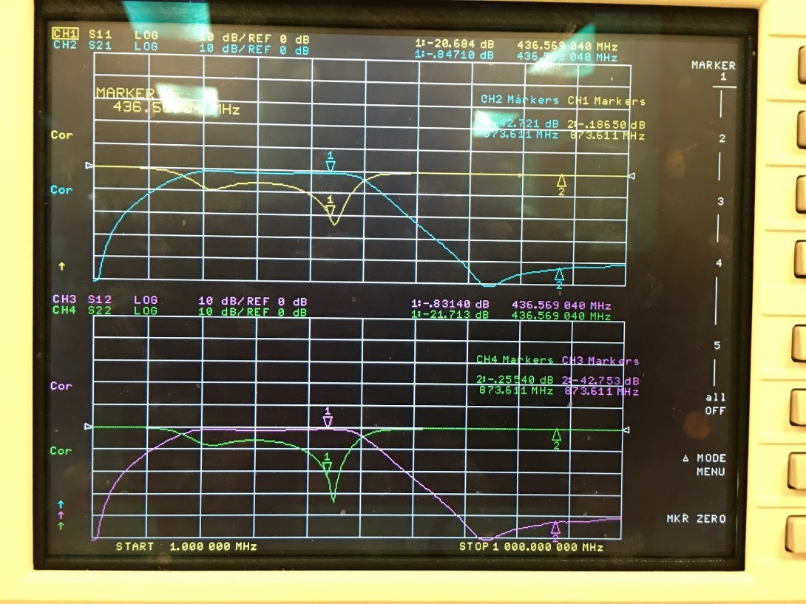
Filter Measurements (LGR)

Slide 31
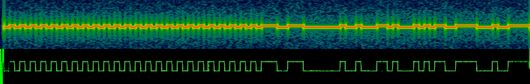
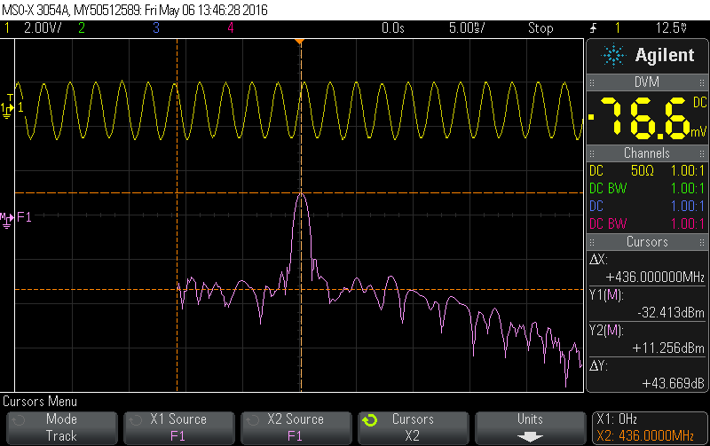
Radio Test (LGR)

Slide 32
System Controller (SC)
Purpose
Requirements
Block Diagram
Schematic
Layout
Firmware
Testing Results

Slide 33

Purpose (SC)
The System Controller is entrusted to perform two main tasks that are essential to the success of the CubeSat. These include the task of system monitor (watchdog) and the task of power management.
The System Controller is the second of the two boards completed for the Sputnik C3 Capstone. It contains an ATMega128 microcontroller, optical isolation between itself and the LGR and FC boards, and the power management circuitry for the system.

Slide 34
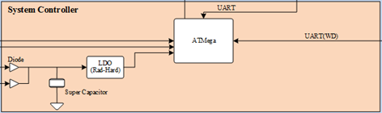
Block Diagram (SC)

Slide 35
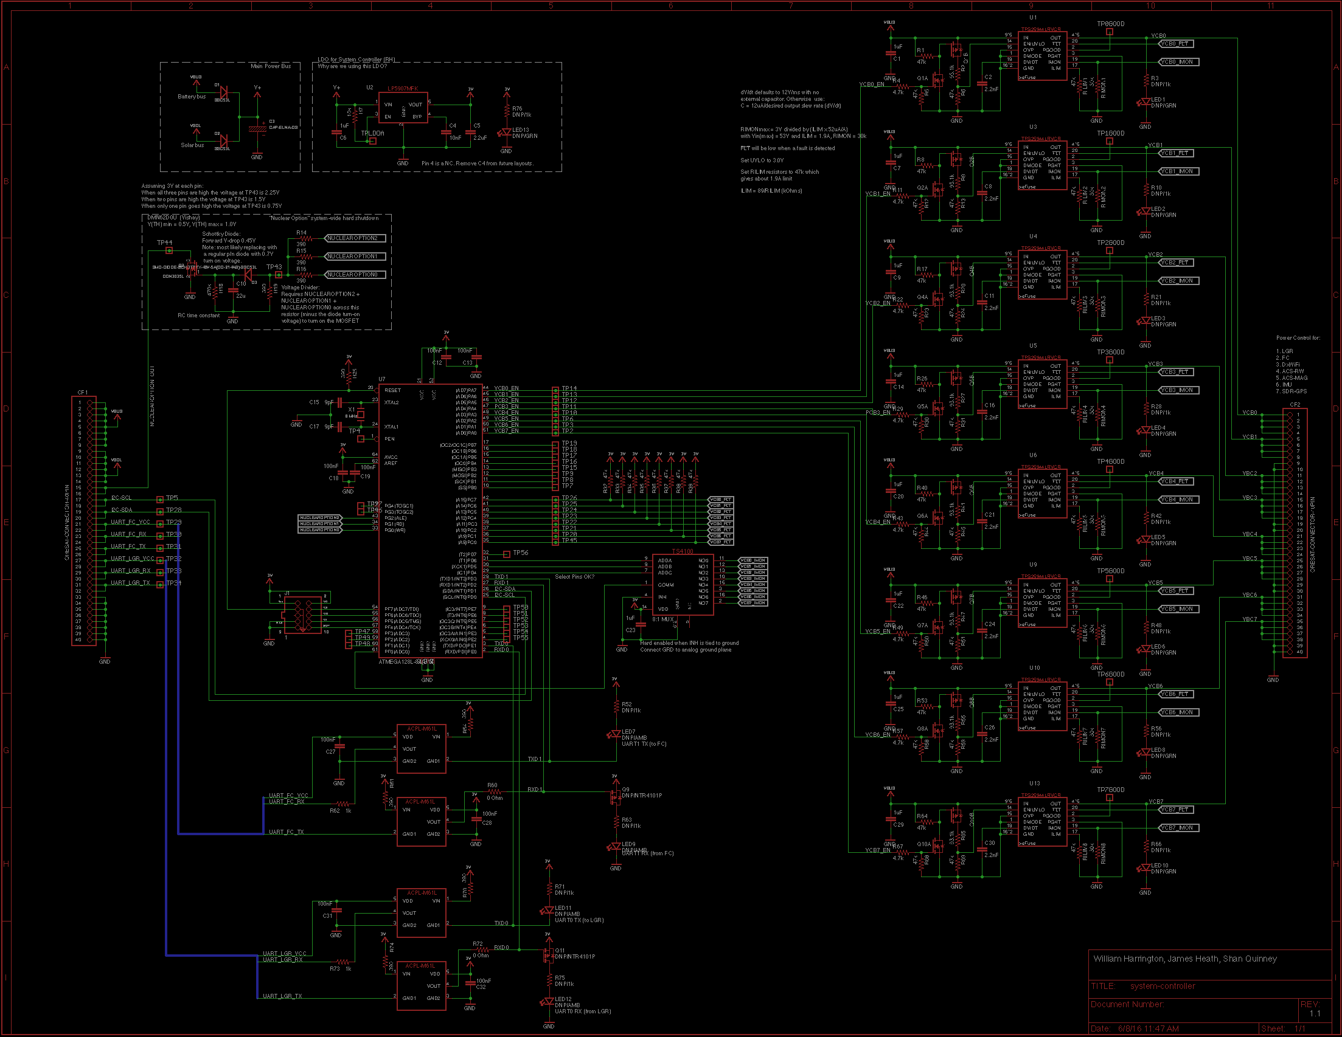
Schematic (SC)
Notes:
35

Slide 36
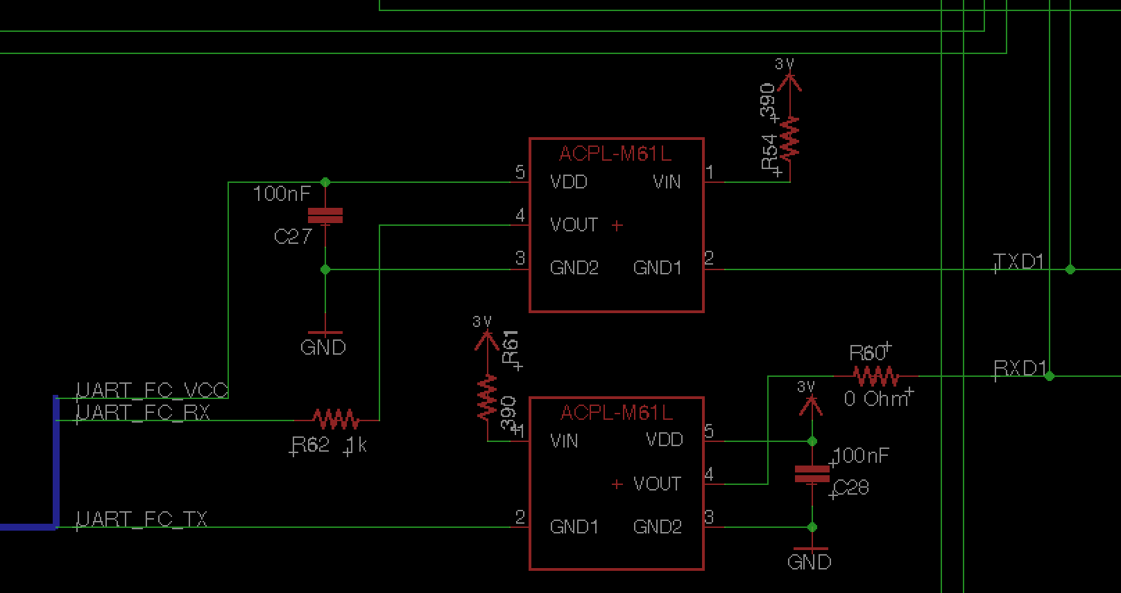
Implementation –Schematic (SC)

Slide 37
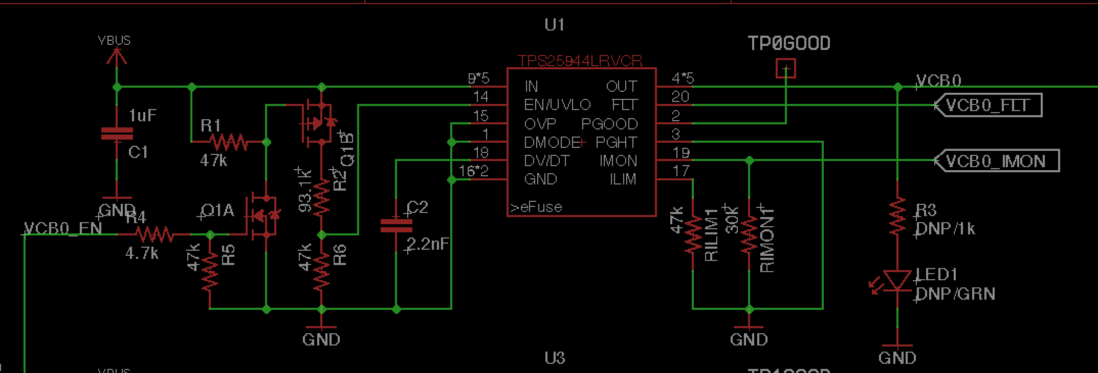
eFuse Schematic (SC)

Slide 38
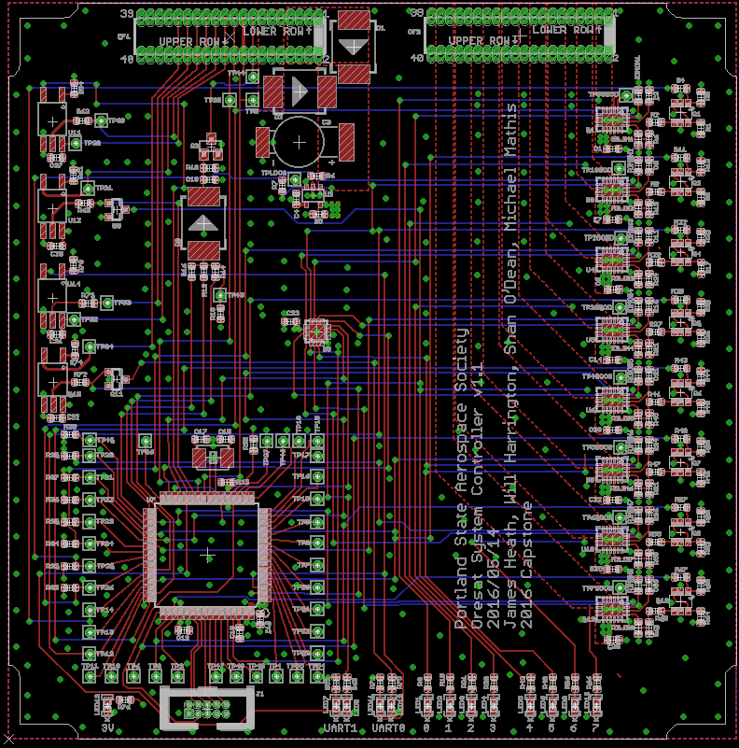
Board Layout (SC)
Notes:
38

Slide 39
Firmware (SC)
ATMega microcontrollers have a very developed driver ecosystem
The system controller listens on UART and I2C for status updates from the payload, LGR, and power system
If the LGR does not check in with a status, the SC will reset it
If there is an error with module, possibly due to a radiation latch-up event, the system controller can power cycle each subsystem individually
If the power system needs to be reset, the system controller is powered by the on-board super capacitor. This can power the system controller for 15-30 seconds
When the system controller listens to the LGR it will also recognize commands sent from the ground station and execute them

Slide 40
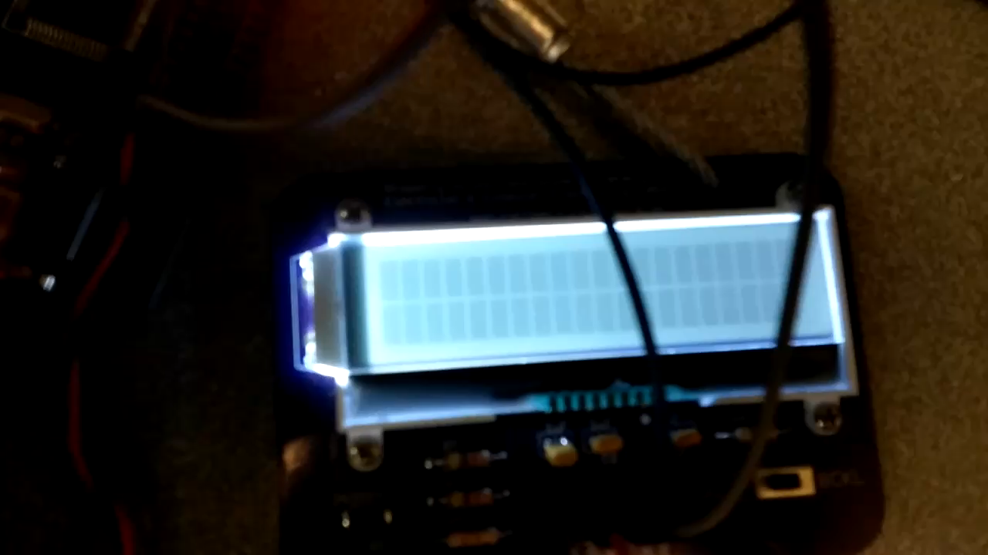
Testing (SC)

Slide 41
Sputnik Functionality/Distance Test
Could not test the sputnik project at a distance of 400 km
Settled for 10 km
This is the final test of Sputnik’s capabilities
Notes:
Example of System Testing
41

Slide 42
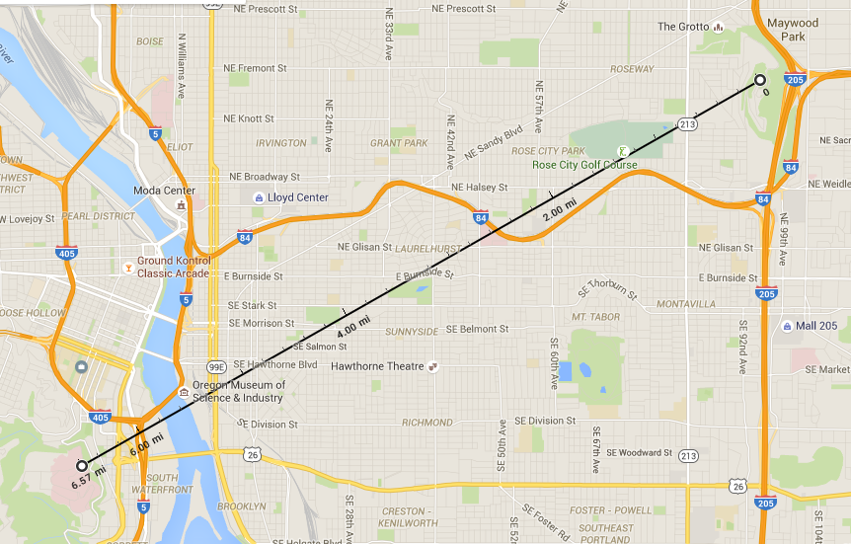
Distance
Total Distance:
10.57 km
Rocky
Butte
OHSU
Notes:
Example of Interface Testing
42

Slide 43
Test Setup
Pictures of testing and video
Notes:
Example of Interface Testing
43

Slide 44
Sputnik Test Results
Test | Result
Component Test | Passed
Supply Range Test | Passed
Radio Test | Passed
Command Test | Passed
Control Test | Passed
Final Test | Passed

Slide 45
Requirements with Results
Initial Requirements | Final Status | Completion
Parts temperature rated (-40 to 80C) | No change | Completed
Radio in 70cm band | No change | Completed
10km link budget | No change | Completed
Power without sunlight | No change | Completed
Energy source switching | No change | Completed
Environmental Tests (vacuum, temperature, acceleration) | Removed | N/A – The prototype will not be used in harsh environments
Radiation Tolerant Watchdog | No change | Completed
Power switches for other blocks | No change | Completed
Conforms to CubeSat standard | No change | Completed
Monitor Energy Storage | Removed | N/A - Power system management removed

Slide 46
Budget Up to $1000
Item | Cost
System Controller Stencil (2) | $33.46
Low-Gain-Radio Stencil (2) | $52.08
System Controller Parts (With Spares) | $307.96
Low Gain Radio Parts (With Spares) | $200.89
System Controller Board (3) | $153.70
Low Gain Radio Board (3) | $153.70
Total | $901.79

Slide 47
Impact

Slide 48
Changes and Improvements
No NXP (maybe)
Inverter
Skyworks LNA

Slide 49
Lessons Learned
Hack sessions, working together
More communication between teams
Work on harder tasks together

Slide 50
IP and Prior Work
Datasheets
Freescale/NXP
Silicon Labs
Murata
Microchip Technology
Micrel
All open source
ATMega drivers from Peter Fleury
Notes:
Brief summarize what use you made of prior work or IP including but not limited to ideas, designs, schematics, board layouts, code.
50

Slide 51

Acknowledgments
Portland State University
Aerospace Society (PSAS)
Andrew
Glenn
Theo
Kenny
Jaime
Eric
Notes:
51

Slide 52
Q&A / DEMO

